Slide 1
Proteins: Chains of Amino Acids
Proteins are made of amino acids linked together in a “chemical chain”.
These chains are folded into three-dimensional shapes.
In the computer, the amino acids are represented by letters of the alphabet (e.g., V = Valine, I = Isoleucine)

Slide 2
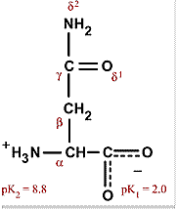
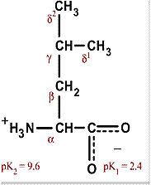
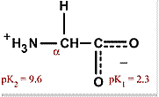
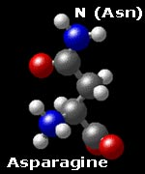
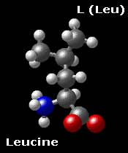
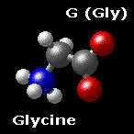
3 types of amino acids: Notice they only differ by atoms in the SIDE CHAIN (in green).
G
N
L

Slide 3
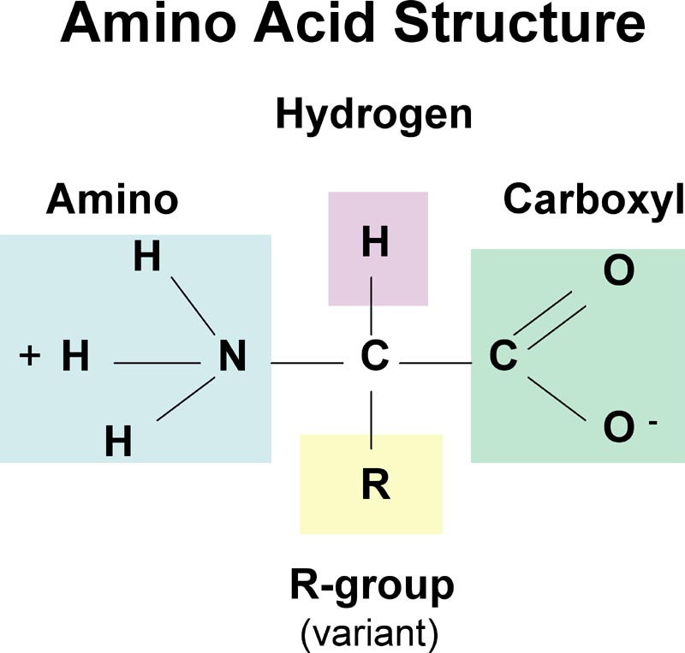
Side Chain (R-group)
There are 20 different types of amino acids. All of them have the same the atoms in the central amino acid structure. How they differ? The Side Chain – (R is used as a place holder.)

Slide 4
Peptides, Structure, Hydrophobicity

Slide 5
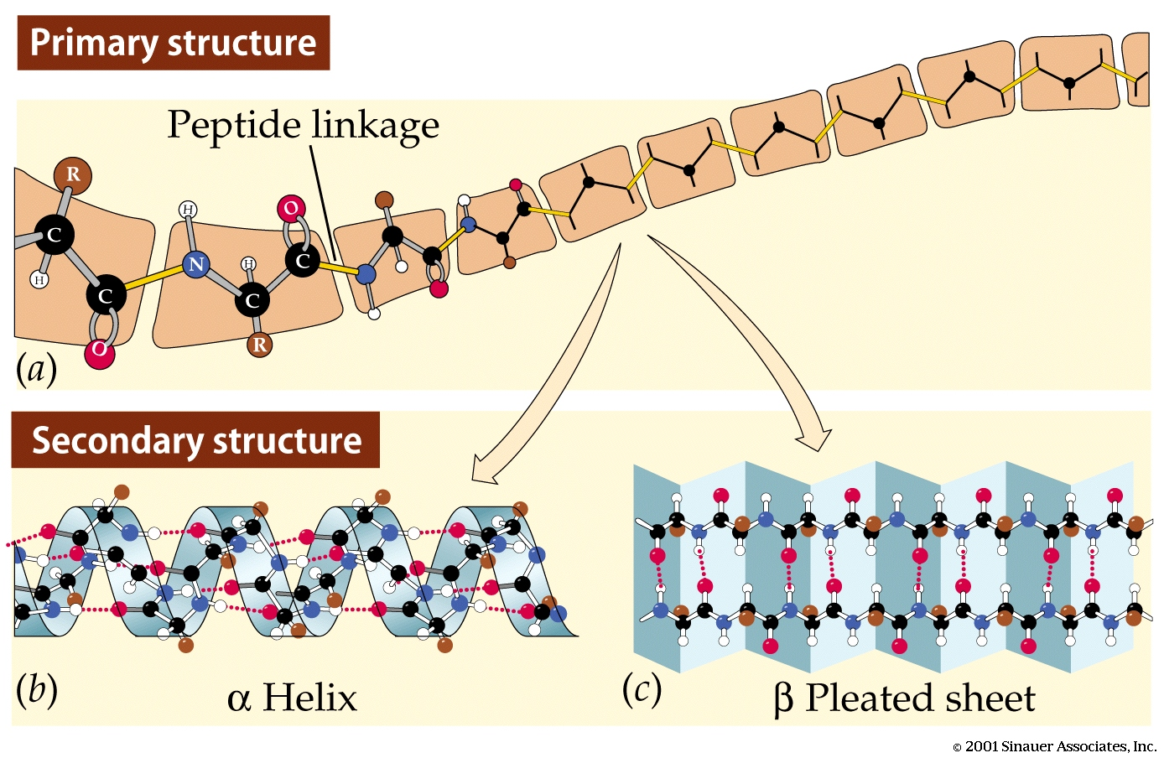
Primary/Secondary structure
This is the order of the amino acids in the chain
Depending on the types and order of amino acids, protein chains can fold into helices or sheets, called the secondary structure.

Slide 6
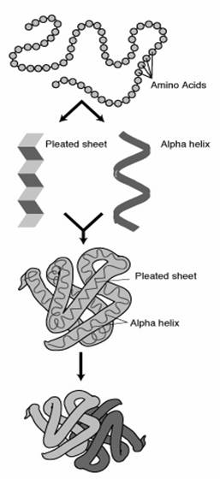
The chain of amino acids is the primary structure.
These chains fold into two common shapes: alpha helix and beta sheets.
This is the secondary structure.
The helices and sheets then fold one more time and you get the tertiary structure.
Some proteins are collections of multiple different proteins bound together – this is the quaternary structure.
https://proteome-software.wikispaces.com/Introduction+to+Proteomics

Slide 7
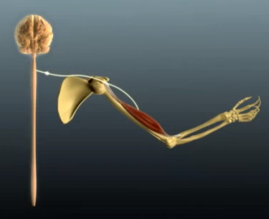
Moving Muscles: Key membrane protein – acetylcholine receptor
Video: Moving a Muscle – click image
Link: https://www.youtube.com/watch?v=CLS84OoHJnQ

Slide 8
Cell membrane & Transmembrane Proteins

Slide 9
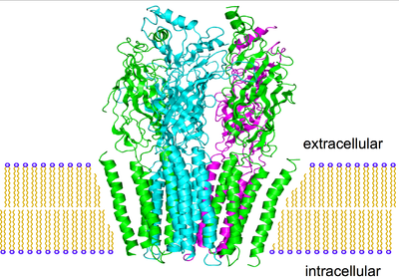
Acetlycholine Receptor

Slide 10
So you have a new protein. Is it a membrane protein? Does it have a transmembrane domain?
> Unknown protein sequence
MGAAVFFGCTFVAFGPAFALFLITVAGDPLRVIILVAGAFFWLVSLLLASVVWFILVHVT
DRSDARLQYGLLIFGAAVSVLLQEVFRFAYYKLLKKADEGLASLSEDGRSPISIRQMAYV
SGLSFGIISGVFSVINILADALGPGVVGIHGDSPYYFLTSAFLTAAIILLHTFWGVVFFD
ACERRRYWALGLVVGSHLLTSGLTFLNPWYEASLLPIYAVTVSMGLWAFITAGGSLRSIQ
RSLLCRRQEDSRVMVYSALRIPPED

Slide 11
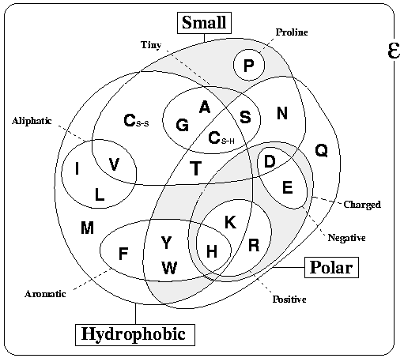
Basic Properties of Amino Acids

Slide 12
Pre-Exercise: Hydrophobicity

Slide 13
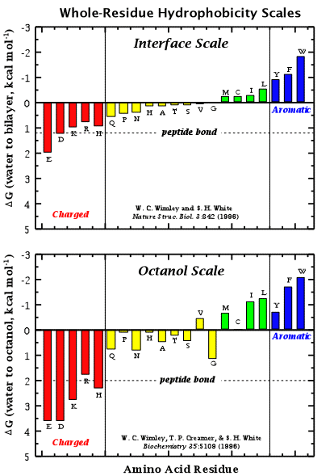
Hydrophobicity Scale
Composed of experimentally determined transfer free energies for each amino acid.

Slide 14
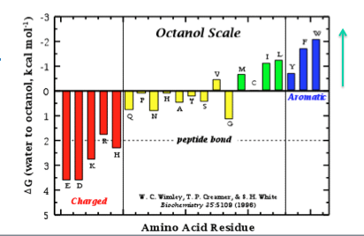
BIOINFORMATICS
You have a protein of UNKNOWN function – Does it have a transmembrane region?
Find the most hydrophobic region. Can you score it?
(Give it a value for Hydrophobicity?)
D E R K P Y L V A W M K R

Slide 15
BIOINFORMATICS
You have a protein of UNKNOWN function – Does it have a transmembrane region?
Find the most hydrophobic region. Can you score it?
(Give it a value for Hydrophobicity?)
D E R K P Y L V A W M K R

Slide 16
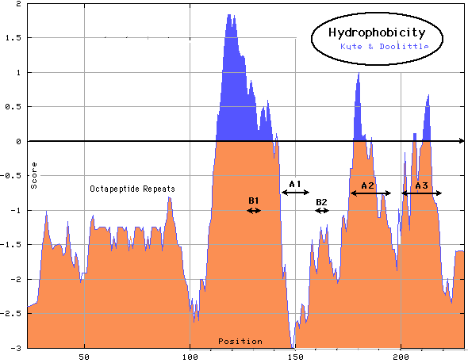
KYTE-DOOLITTLE Hydrophobicity Values
for mature chimp prion protein
Arg:
-4.5
Ser:
-0.8
Lys:
-3.9
Thr:
-0.7
Asn:
-3.5
Gly:
-0.4
Asp:
-3.5
Ala:
1.8
Gln:
-3.5
Met:
1.9
Glu:
-3.5
Cys:
2.5
His:
-3.2
Phe:
2.8
Pro:
-1.6
Leu:
3.8
Tyr:
-1.3
Val:
4.2
Trp:
-0.9
Ile:
4.5
Calculate the AVERAGE hydrophobicity over a “window”

Slide 17
Calculate Hydrophobicity
h_{i}
h_{i}
Window Size = 5
Arg, R:
-4.5
Ser, S:
-0.8
Lys, K:
-3.9
Thr, T:
-0.7
1
N
N
Σ h_{i}
Asn, N:
-3.5
Gly, G:
-0.4
i=0
Asp, D:
-3.5
Ala, A:
1.8
Gln, Q:
-3.5
Met, M:
1.9
K K R P L L V A
Glu, E:
-3.5
Cys, C:
2.5
-3.9 -3.9 -4.5 -1.6 3.8
His, H:
-3.2
Phe, F:
2.8
Pro, P:
-1.6
Leu, L:
3.8
Tyr, Y:
-1.3
Val, V:
4.2
- 2.0
Trp, W:
-0.9
Ile, I:
4.5

Slide 18
Calculate Hydrophobicity
h_{i}
h_{i}
Window Size = 5
Arg, R:
-4.5
Ser, S:
-0.8
Lys, K:
-3.9
Thr, T:
-0.7
1
N
N
Σ h_{i}
Asn, N:
-3.5
Gly, G:
-0.4
i=0
Asp, D:
-3.5
Ala, A:
1.8
Gln, Q:
-3.5
Met, M:
1.9
K K R P L L V A
Glu, E:
-3.5
Cys, C:
2.5
-3.9 -4.5 -1.6 3.8 3.8
His, H:
-3.2
Phe, F:
2.8
Pro, P:
-1.6
Leu, L:
3.8
Tyr, Y:
-1.3
Val, V:
4.2
- 0.5
Trp, W:
-0.9
Ile, I:
4.5

Slide 19
Calculate Hydrophobicity
h_{i}
h_{i}
Window Size = 5
Arg, R:
-4.5
Ser, S:
-0.8
Lys, K:
-3.9
Thr, T:
-0.7
1
N
N
Σ h_{i}
Asn, N:
-3.5
Gly, G:
-0.4
i=0
Asp, D:
-3.5
Ala, A:
1.8
Gln, Q:
-3.5
Met, M:
1.9
K K R P L L V A
Glu, E:
-3.5
Cys, C:
2.5
-4.5 -1.6 3.8 3.8 4.2
His, H:
-3.2
Phe, F:
2.8
Pro, P:
-1.6
Leu, L:
3.8
Tyr, Y:
-1.3
Val, V:
4.2
+1.2
Trp, W:
-0.9
Ile, I:
4.5

Slide 20
Calculate Hydrophobicity
h_{i}
h_{i}
Window Size = 5
Arg, R:
-4.5
Ser, S:
-0.8
Lys, K:
-3.9
Thr, T:
-0.7
1
N
N
Σ h_{i}
Asn, N:
-3.5
Gly, G:
-0.4
i=0
Asp, D:
-3.5
Ala, A:
1.8
Gln, Q:
-3.5
Met, M:
1.9
K K R P L L V A
Glu, E:
-3.5
Cys, C:
2.5
His, H:
-3.2
Phe, F:
2.8
Pro, P:
-1.6
Leu, L:
3.8
Tyr, Y:
-1.3
Val, V:
4.2
?
Trp, W:
-0.9
Ile, I:
4.5

Slide 21
Calculate Hydrophobicity
h_{i}
h_{i}
Window Size = 5
Arg, R:
-4.5
Ser, S:
-0.8
Lys, K:
-3.9
Thr, T:
-0.7
1
N
N
Σ h_{i}
Asn, N:
-3.5
Gly, G:
-0.4
i=0
Asp, D:
-3.5
Ala, A:
1.8
Gln, Q:
-3.5
Met, M:
1.9
K K R P L L V A
Glu, E:
-3.5
Cys, C:
2.5
His, H:
-3.2
Phe, F:
2.8
Pro, P:
-1.6
Leu, L:
3.8
Tyr, Y:
-1.3
Val, V:
4.2
2.4
Trp, W:
-0.9
Ile, I:
4.5

